Slide 1
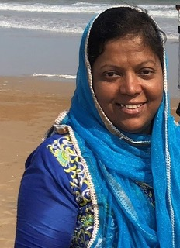
Leena with ServeTrust
Serving her people during the Covid 19 Pandemic

Slide 2
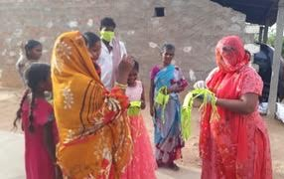
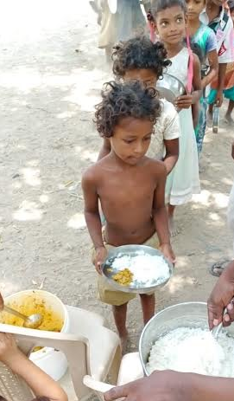
As always Leena responds to a crisis
Leena has ordered 8000 masks using a tailor and a fabric store. These have been given to many in need. Local traders give her credit as she is well respected in her society.
Rice and lentils are given to hungry adults and children.

Slide 3
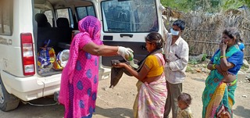
Lee
Early in the morning Leena and her staff distribute masks, lentils and rice to poor villagers many of whom can no longer earn money to buy food.

Slide 4
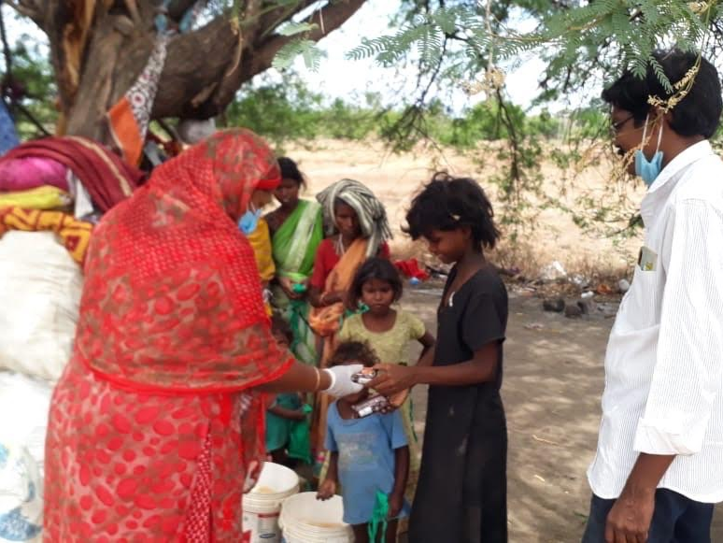
ServeTrust feeds children who would otherwise be begging on the streets

Slide 5
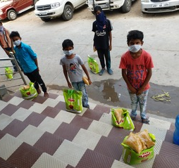
ServeTrust provides masks and other essentials to impoverished children
in urban areas.

Slide 6
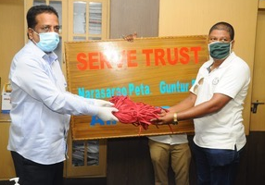
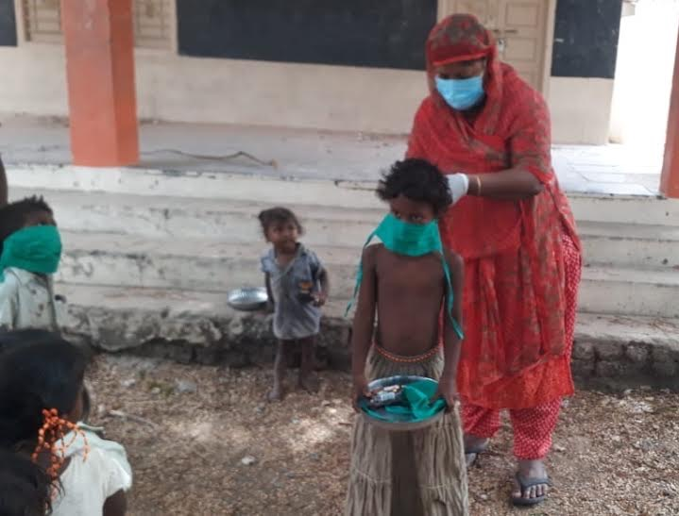
Masks have been donated to local hospitals, policemen and sanitation workers as well as children

Slide 7
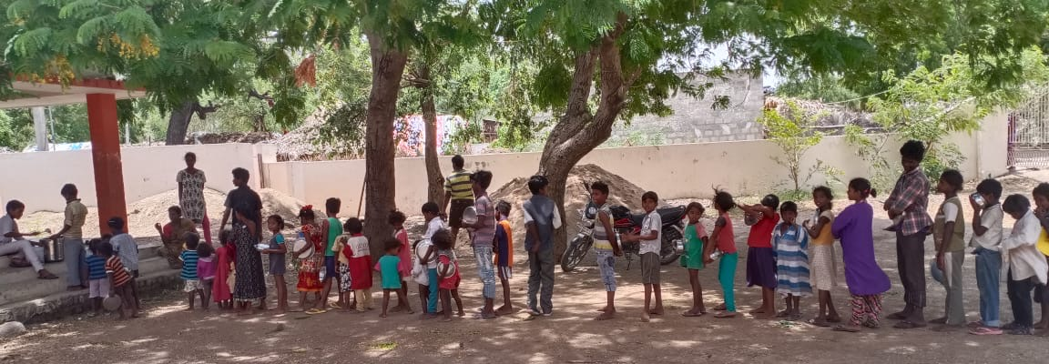
“For I was hungry and you gave me something to eat, ….I was sick and you looked after me,…Truly I tell you, whatever you did for one of the least of these brothers and sisters of mine, you did for me”
(Leena and ServeTrust living out Matthew 25)

Slide 8
Please Pray
Pray for Leena’s town which is in an exposed area.
Leena is at risk. Pray for her safety as she still visits villages each day.
Pray that there will be food as items are becoming scarce including vegetables and eggs.

Slide 9
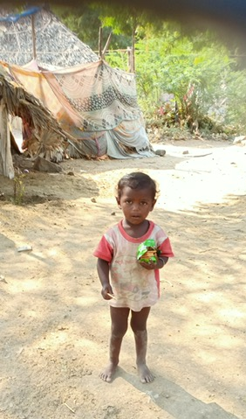
Leena continues to care
for the poorest of God’s children.
She thanks
you for being partners in this work.

